Slide 1
Java Capability
Exception Handling

Slide 2
Agenda
Introduction
Types of Exception
Exception Handling mechanism
User Defined Exception

Slide 3
Prerequisites
Basic programming skill
Java knowledge mandatory

Slide 4
Introduction
An exception (or exceptional event) is a problem that arises during the execution of a program. When an Exception occurs the normal flow of the program is disrupted and the program/Application terminates abnormally, which is not recommended, therefore, these exceptions are to be handled.
An exception can occur for many different reasons. Following are some scenarios where an exception occurs.
A user has entered an invalid data.
A file that needs to be opened cannot be found.
A network connection has been lost in the middle of communications or the JVM has run out of memory.

Slide 5
Types of Exception
There are mainly two types of exceptions: checked and unchecked where error is considered as unchecked exception. The sun microsystem says there are three types of exceptions:
Checked Exception
Unchecked Exception
Error
Checked exceptions − A checked exception is an exception that occurs at the compile time, these are also called as compile time exceptions. These exceptions cannot simply be ignored at the time of compilation, the programmer should take care of (handle) these exceptions

Slide 6
Types of Exception
Unchecked exceptions − An unchecked exception is an exception that occurs at the time of execution. These are also called as Runtime Exceptions. These include programming bugs, such as logic errors or improper use of an API. Runtime exceptions are ignored at the time of compilation.
Errors − These are not exceptions at all, but problems that arise beyond the control of the user or the programmer. Errors are typically ignored in your code because you can rarely do anything about an error. For example, if a stack overflow occurs, an error will arise. They are also ignored at the time of compilation.
Common scenarios where exceptions may occur.
If we divide any number by zero, there occurs an ArithmeticException.
If you are inserting any value in the wrong index, it would result ArrayIndexOutOfBoundsException

Slide 7
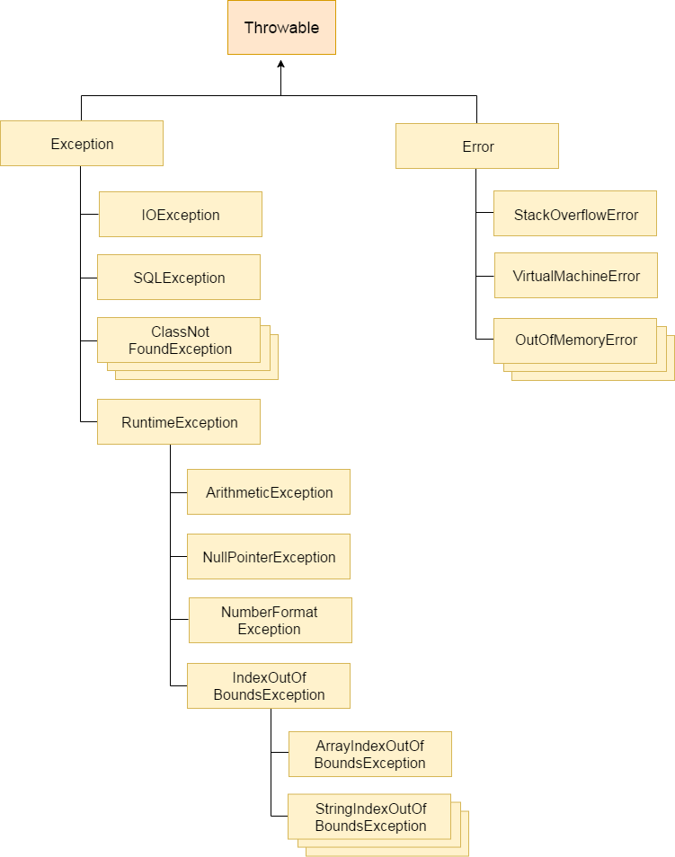
Exception Handling

Slide 8
Exception Handling Mechanism
In java, exception handling is done using five keywords,
try
catch
throw
throws
finally
Exception handling is done by transferring the execution of a program to an appropriate exception handler when exception occurs.

Slide 9
Built in exception
Arithmetic Exception It is thrown when an exceptional condition has occurred in an arithmetic operation.
ArrayIndexOutOfBoundException It is thrown to indicate that an array has been accessed with an illegal index. The index is either negative or greater than or equal to the size of the array.
ClassNotFoundException This Exception is raised when we try to access a class whose definition is not found.
FileNotFoundException This Exception is raised when a file is not accessible or does not open.
IOException It is thrown when an input-output operation failed or interrupted.
InterruptedException It is thrown when a thread is waiting , sleeping , or doing some processing , and it is interrupted.

Slide 10
Built in exception
NoSuchFieldException It is thrown when a class does not contain the field (or variable) specified.
NoSuchMethodException It is thrown when accessing a method which is not found.
NullPointerException This exception is raised when referring to the members of a null object. Null represents nothing.
NumberFormatException This exception is raised when a method could not convert a string into a numeric format.
RuntimeException This represents any exception which occurs during runtime.
StringIndexOutOfBoundsException It is thrown by String class methods to indicate that an index is either negative than the size of the string

Slide 11
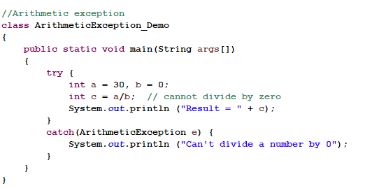
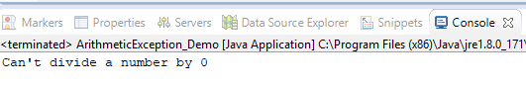
Examples of Built-in Exception:
Output:

Slide 12
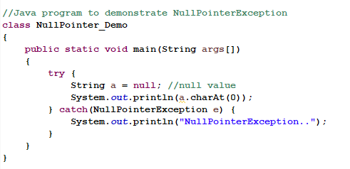
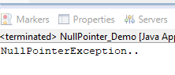
Null Pointer Exception
Output:

Slide 13
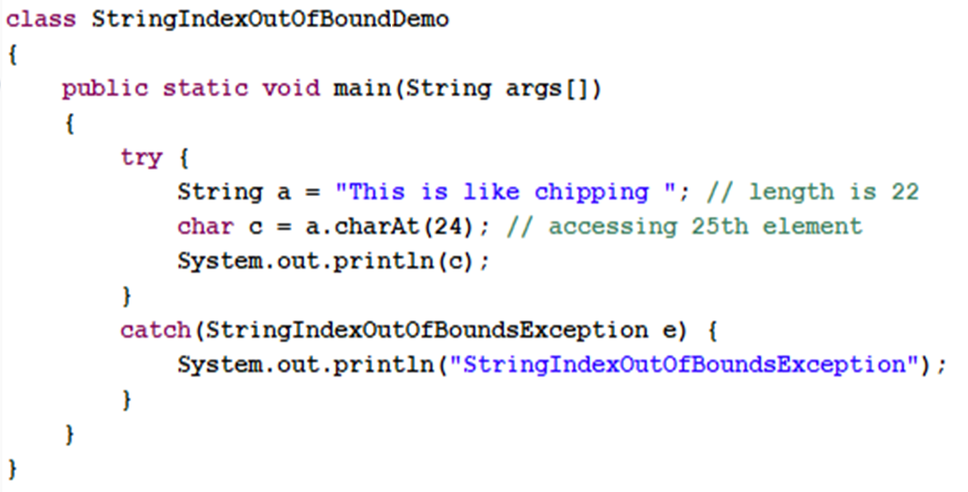
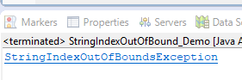
String Index Out Of Bounds exception
Output:

Slide 14
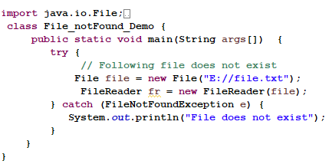
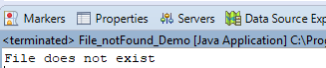
FILE NOT FOUND EXCEPTION
FileNotFoundDemo
Output:

Slide 15
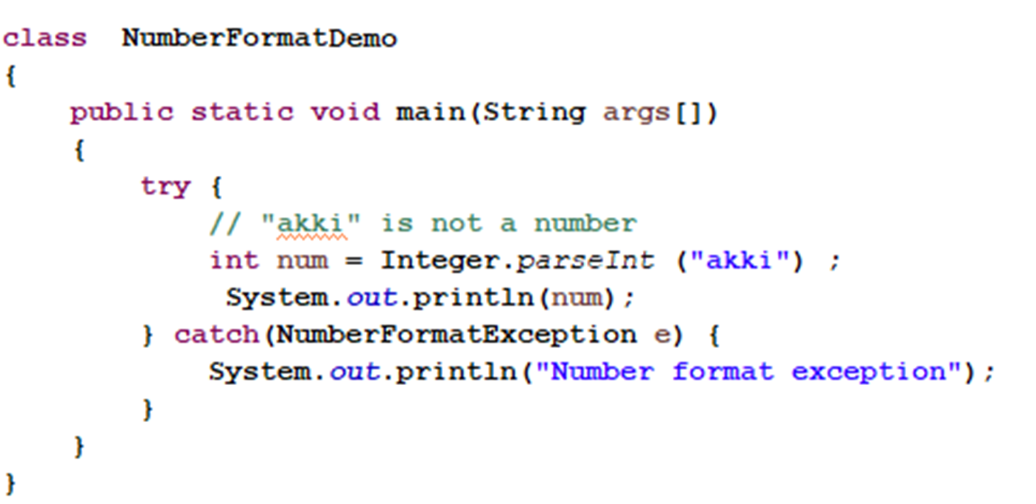
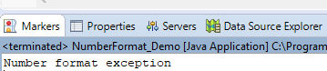
NUMBER FORMAT EXCEPTION
Output:

Slide 16
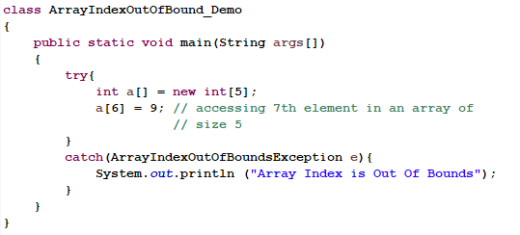
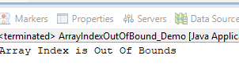
Arrays Index out of bounds exception
Output:

Slide 17
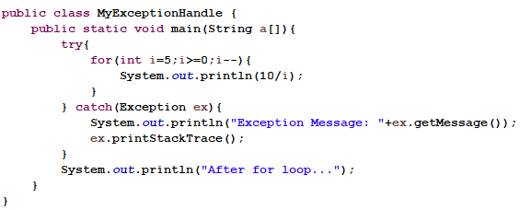
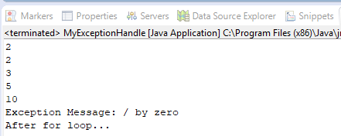
EXCEPTION EXAMPLE
Output:

Slide 18
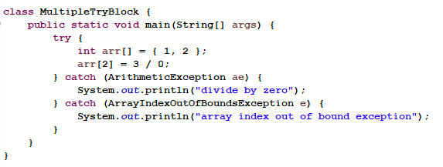
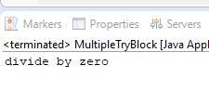
MULTIPLE CATCH BLOCKS
Output:

Slide 19
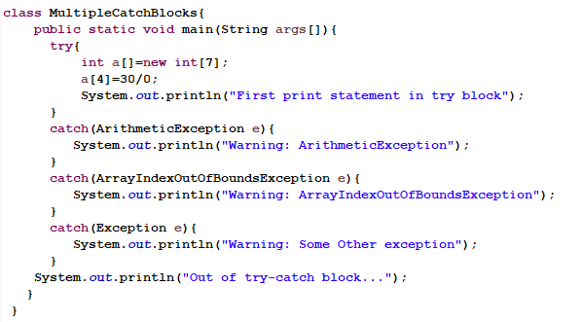
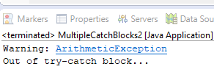
MULTIPLE CATCH BLOCKS
Output:

Slide 20
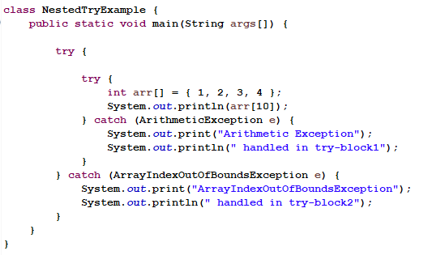
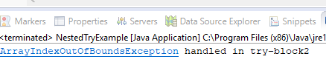
NESTED TRY EXAMPLE
Output:

Slide 21
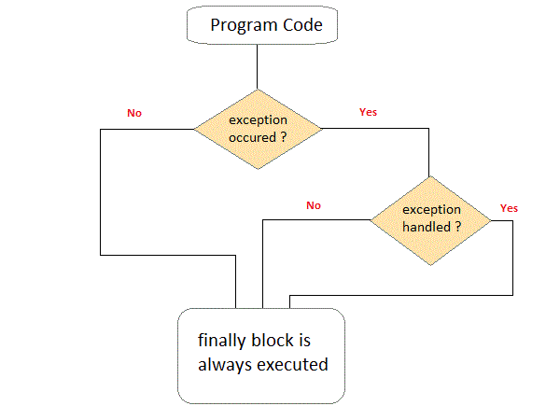
finally block
Java finally block is a block that is used to execute important code such as closing connection, stream etc.
Java finally block is always executed whether exception is handled or not.
Java finally block follows try or catch block.

Slide 22
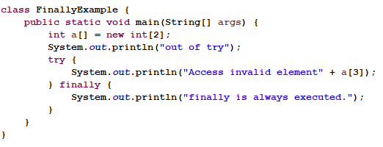
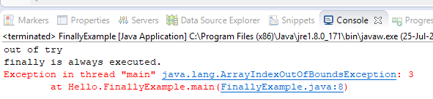
FINALLY EXAMPLE
Output:

Slide 23
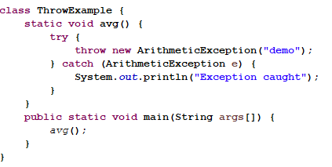
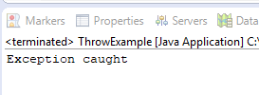
throw keyword
The Java throw keyword is used to explicitly throw an exception.
We can throw either checked or unchecked exception in java by throw keyword. The throw keyword is mainly used to throw custom exception
Output:

Slide 24
Throws Keyword
The Java throws keyword is used to declare an exception. It gives an information to the programmer that there may occur an exception so it is better for the programmer to provide the exception handling code so that normal flow can be maintained.
Exception Handling is mainly used to handle the checked exceptions. If there occurs any unchecked exception such as NullPointerException, it is programmers fault that he is not performing check up before the code being used.
Checked exception (compile time) force you to handle them, if you don’t handle them then the program will not compile.
Throws keyword is used for handling checked exceptions . By using throws we can declare multiple exceptions in one.

Slide 25
Throws keyword
throws is used to throw an exception object implicitly. It is used with the method signature. More than one type of exception can be declared with method signature, they should be comma separated.
Note:
throws is mainly used to throw checked exception.
If you are calling a method that declares an exception, you must either caught or declare the exception.
We can rethrow the exception.

Slide 26
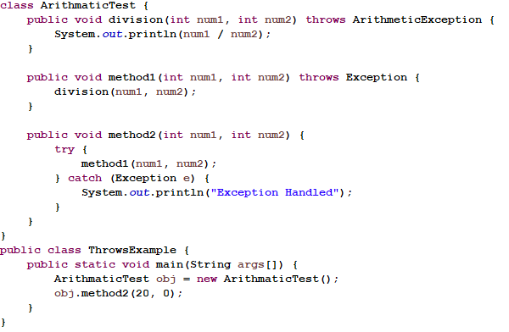
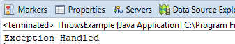
Throws example
Output:

Slide 27
Difference between throw and throws
throw | throws
throw keyword is used to throw an exception explicitly. | throws keyword is used to declare an exception possible during its execution.
throw keyword is followed by an instance of Throwable class or one of its sub-classes. | throws keyword is followed by one or more Exception class names separated by commas.
throw keyword is declared inside a method body. | throws keyword is used with method signature (method declaration).
We cannot throw multiple exceptions using throw keyword. | We can declare multiple exceptions (separated by commas) using throws keyword.

Slide 28
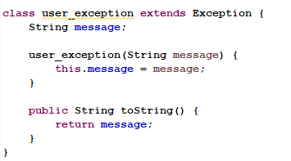
User Defined Exception
If you are creating your own Exception that is known as custom exception or user-defined exception. Java custom exceptions are used to customize the exception according to user need.
By the help of custom exception, you can have your own exception and message.

Slide 29
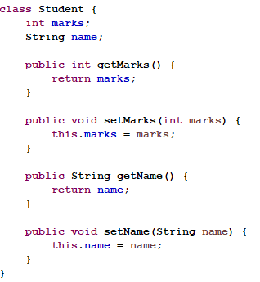
User Defined Exception

Slide 30
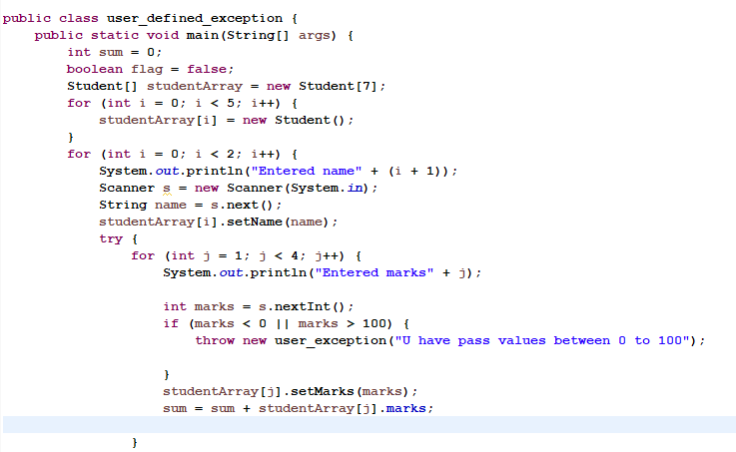
User Defined Exception

Slide 31
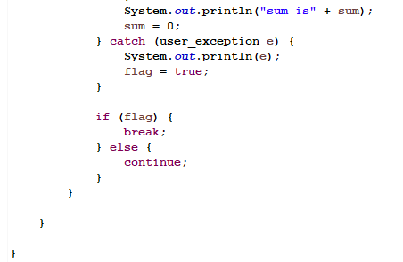
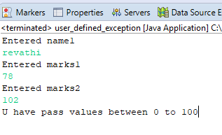
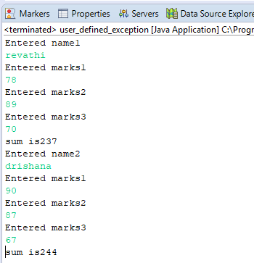
User Defined Exception
Output:
Output:

Slide 32
MEMORY MANAGEMENT INTRODUCTION
In C/C++, programmer is responsible for both creation and destruction of objects. Usually programmer neglects destruction of useless objects. Due to this negligence, at certain point, for creation of new objects, sufficient memory may not be available and entire program will terminate abnormally causing OutOfMemoryErrors.
But in Java, the programmer need not to care for all those objects which are no longer in use. Garbage collector destroys these objects.
Garbage collector is best example of Daemon thread as it is always running in background.
Main objective of Garbage Collector is to free heap memory by destroying unreachable objects.

Slide 33
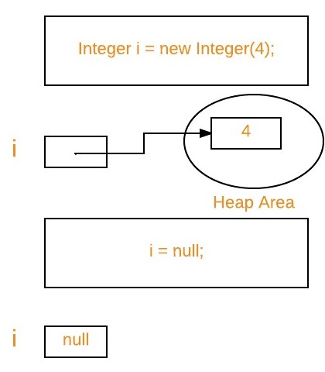
Important terms :
Unreachable objects : An object is said to be unreachable iff it doesn’t contain any reference to it. Also note that objects which are part of island of isolation are also unreachable.
Eligibility for garbage collection : An object is said to be eligible for GC(garbage collection) if it is unreachable. In above image, after i = null; integer object 4 in heap area is eligible for garbage collection

Slide 34
Ways to make an object eligible for GC
Even though programmer is not responsible to destroy useless objects but it is highly recommended to make an object unreachable(thus eligible for GC) if it is no longer required.
There are generally four different ways to make an object eligible for garbage collection.
Nullifying the reference variable
Re-assigning the reference variable
Object created inside method
Island of Isolation
Note :
There is no guarantee that any one of above two methods will definitely run Garbage Collector.
The call System.gc() is effectively equivalent to the call : Runtime.getRuntime().gc()

Slide 35
How to make object eligible for garbage collection
Once we made object eligible for garbage collection, it may not destroy immediately by garbage collector. Whenever JVM runs Garbage Collector program, then only object will be destroyed. But when JVM runs Garbage Collector, we can not expect.
We can also request JVM to run Garbage Collector. There are two ways to do it :
Using System.gc() method : System class contain static method gc() for requesting JVM to run Garbage Collector.
Using Runtime.getRuntime().gc() method : Runtime class allows the application to interface with the JVM in which the application is running. Hence by using its gc() method, we can request JVM to run Garbage Collector.

Slide 36
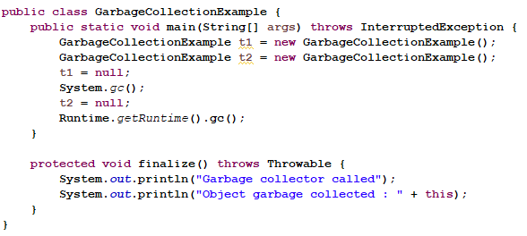
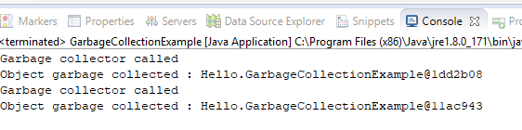
Example
Output:

Slide 37
Finalization
Just before destroying an object, Garbage Collector calls finalize() method on the object to perform cleanup activities. Once finalize() method completes, Garbage Collector destroys that object.
finalize() method is present in Object class with following prototype. protected void finalize() throws Throwable.
Based on our requirement, we can override finalize() method for perform our cleanup activities like closing connection from database.

Slide 38
Finalization
Note :
The finalize() method called by Garbage Collector not JVM. Although Garbage Collector is one of the module of JVM.
Object class finalize() method has empty implementation, thus it is recommended to override finalize() method to dispose of system resources or to perform other cleanup.
The finalize() method is never invoked more than once for any given object.
If an uncaught exception is thrown by the finalize() method, the exception is ignored and finalization of that object terminates

Slide 39
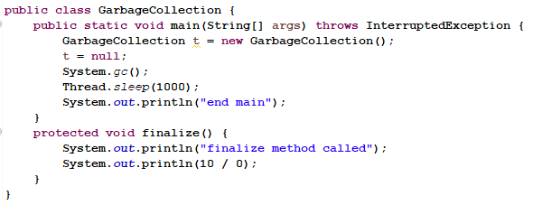
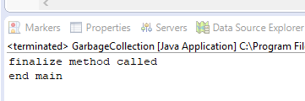
Example
Output:

Slide 40
Quiz
Output of following Java program?
class Main {
public static void main(String args[]) {
int x = 0;
int y = 10;
int z = y/x;
}
}
(A) Compiler Error
(B) Compiles and runs fine
(C) Compiles fine but throws ArithmeticException exception

Slide 41
Quiz
Pick runtime exception?....
A.ClassCastException
B. FileNotFoundException
C. NullPointerException
D. SecurityException
E. Above all
A try with finally without catch can declare the exception
A. True
B. False

Slide 42
Quiz
class Test
{
public static void main(String[] args)
{
try
{
int a[]= {1, 2, 3, 4};
for (int i = 1; i <= 4; i++)
{
System.out.println ("a[" + i + "]=" + a[i] + "\n");
}
}

Slide 43
Quiz
catch (Exception e)
{
System.out.println ("error = " + e);
}
catch (ArrayIndexOutOfBoundsException e)
{
System.out.println ("ArrayIndexOutOfBoundsException");
}
}
}
(A) Compiler error (B) Run time error (C) ArrayIndexOutOfBoundsException (D) Error Code is printed (E) Array is printed

Slide 44
Quiz
Which one of the following statement is correct?
A. The ‘try’ block should be followed by a ‘catch’ block.
B. The ‘try’ block should be followed by a ‘finally’ block.
C. The ‘try’ block should be followed by either a ‘catch’ block or a ‘finally’ block.
D. The ‘try’ block should be followed by at least two ‘catch’ blocks.
Parent of Error is.......
A. Object
B. Collections
C. Throwable
D. Exception

Slide 45
Thank you

